Slide 1
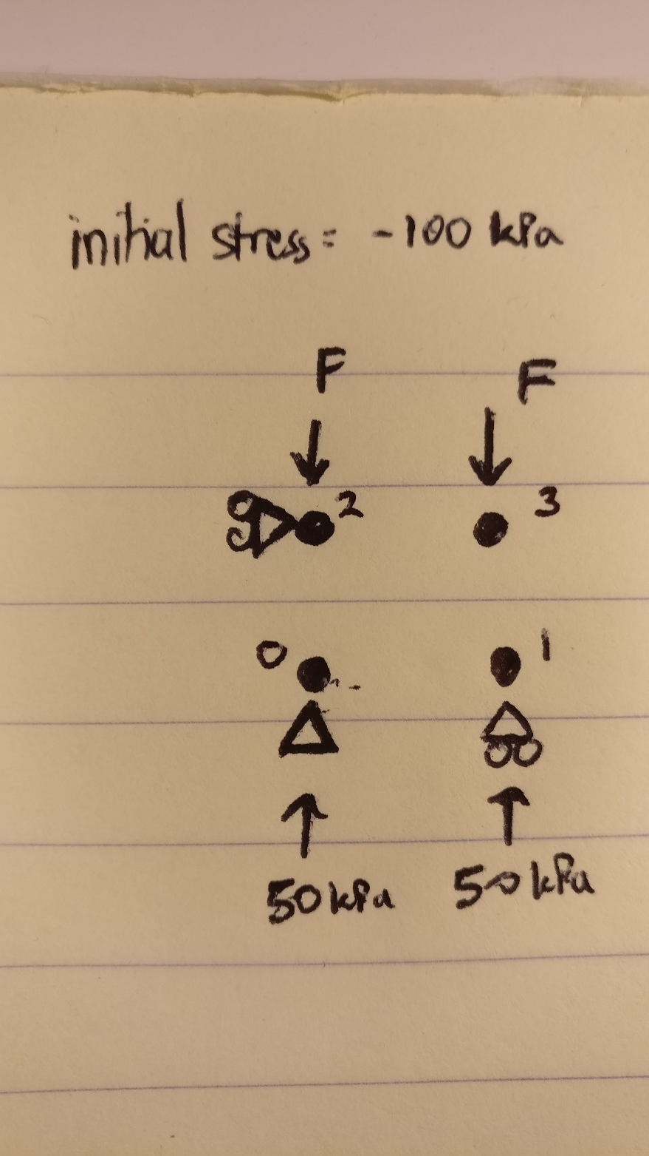
Problem

Slide 2
3 Cases of Initial Conditions
Case 1: with both vertical and horizontal initial stress (100 kPa)
Case 2: with just vertical initial stress
Case 3: without any initial stress
Displacement at final time
Point | Initial |  | 1 |  | 2 |  | 3
 | x | y | x | y | x | y | x | y
0 | 0 | 0 | 0 | 0 | 0 | 0 | 0 | 0
1 | 1 | 0 | 1.10194 | 0 | 0.99065 | 0 | 0.997383 | 0
2 | 0 | 1 | 0 | 1.05426 | 0 | 1.08851 | 0 | 0.977629
3 | 1 | 1 | 1.10194 | 1.05426 | 0.99065 | 1.08851 | 0.997383 | 0.977629

